Slide 1

EICEA
"made for the future"

Slide 2
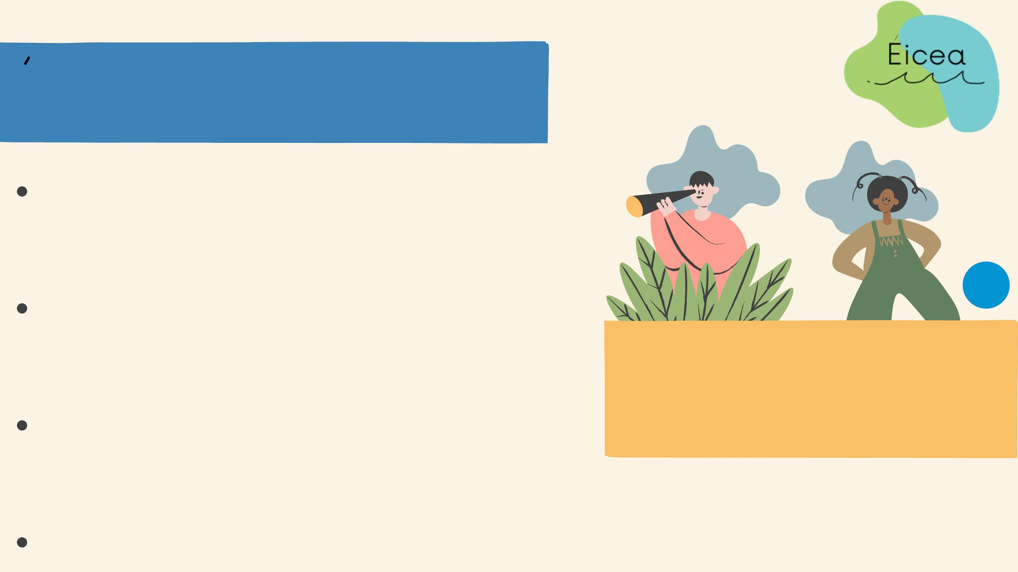
EICEA
ecological sustainable
produtcs
in our team we have 25
employees
"made for the future"
for our produtcs we use plastic
which divers found in the sea
ecologically aware company

Slide 3
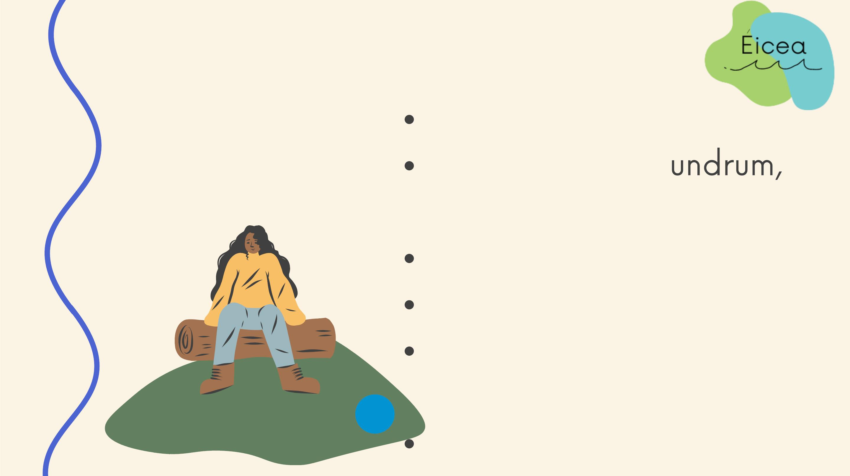
ABOUT US
est. 2022.
Sandyford Rd., D
Dublin 16
working hours: 11-19
soon shipping worldwide
find us on: Instagram,
Facebook and Tik tok
eiceadoo@gmail.com

Slide 4

OUR MISSION
is to clean the sea and provide our
costumers with quality and
enviromental friendly products

Slide 5

OUR VISION
is to inspire costumers to
help people and the
enviromental friendly
products

Slide 6

OUR ASSORTMENT
bottles
lunch boxes
soup bowls
cutlery

Slide 7
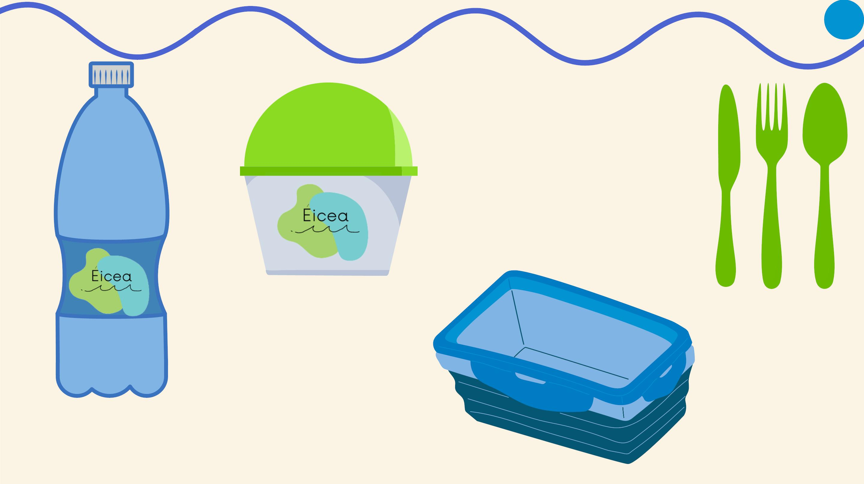
cutlery
soup bowl
lunch box +
your own
design
plastic bottle + your
own design

Slide 8
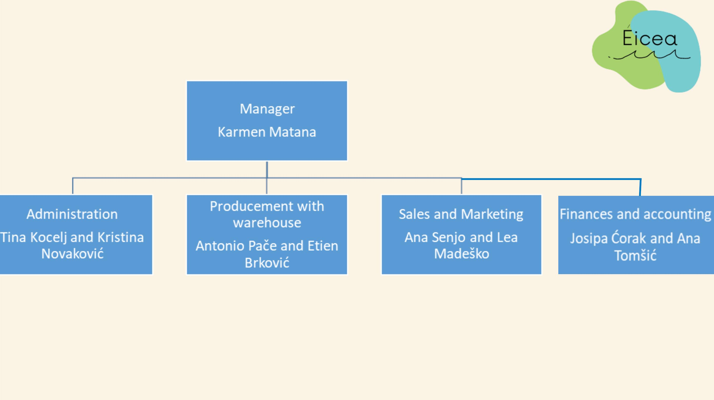
OUR TEAM

Slide 9

STAFF
workers in shop
warehouser
manager
accountant
administrator
marketing expert
computer scientist

Slide 10

OUR COSTUMERS
mostly parents
athletes
other people

Slide 11
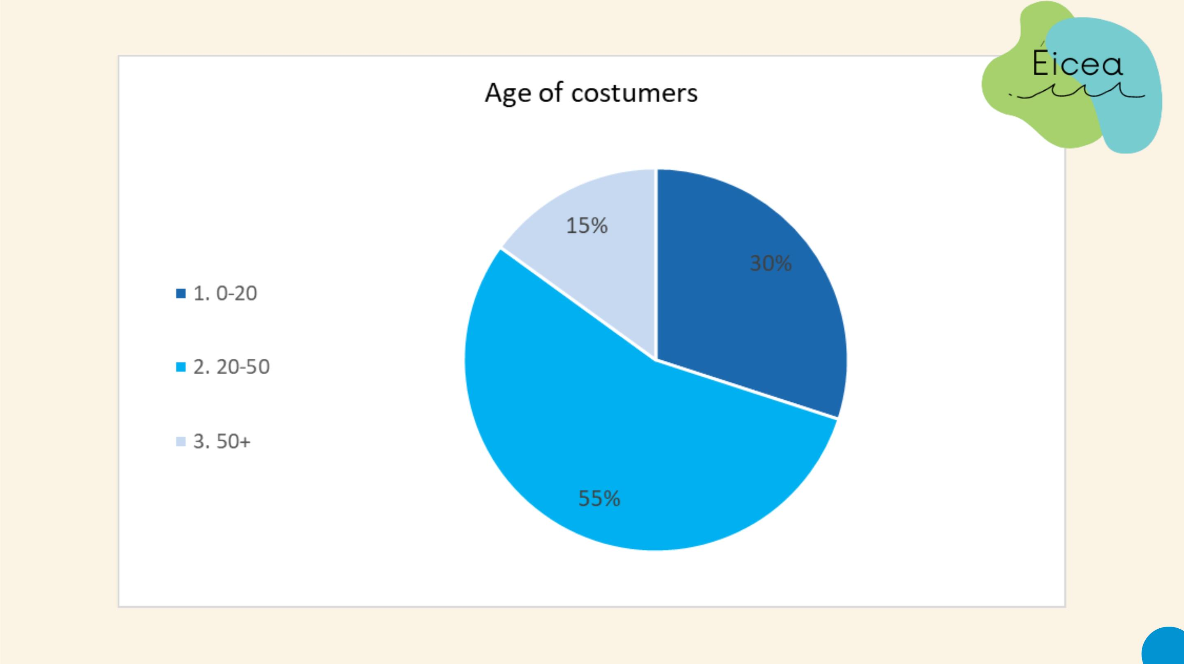

Slide 12

COSTUMER PROFILE
Costumer no. 1
Costum
name: Jaden
name: Holly
job: teacher
job: student
hobby: yoga
hobby: football
sallary: none
sallary: average
social class: middle
relationship: married
family: 2 kids
social class: middle
relationship: none
family: parents and younger sister
pet: turtle
pet: dog

Slide 13

PROMOTION METHODS
bildboards
kids education at school
flyers

Slide 14

MARKET RESEARCH
size of market: Ireland(shipping worldwide
soon)
industry revenue yearly: between 70.000,00€
and 100.000,00€
number of competitors: 3
prices: between 25€ and 150€

Slide 15

KEY COMPETITORS
EQUA
SISTE
+ bottles for coffee and tea
to keep them warm and
single cups
+ helping th
s
people with lunch boxes
and they clean beaches
- poor quality containers:
hard to open, leaks and
lugs break
- not good plasatic and
easy to break

Slide 16

SUPPLY CHAIN
the divers dive out the plastic from the sea
trucks deliver the plastic to the factory
after we seperate the plastic, the useable plastic are being
cleaned before the whole production process
after that, they are being cleaned again and then they are
going to be delivered to the warehouse
in the warehouse, they are waiting to be delivered to the
customer

Slide 17

STRENGHT WEAKNESSES
good location
high expenses
modern technology
low number of own stores
insufficient advertising
enviromentally conscious
EICEA
inovation
changing needs
shipping worldwide
expand our assortment
inflation and deflation
high competition
OPPORTUNITIES THREATS

Slide 18

STRENGHT WEAKNESSES
poor quality of new
helping homeless people
quality
produtcs
not 100% eco
high expenses
recycled plastic
SISTEMA
good image
competitors
marketing expansion
assortment extension
changing needs
demographic changes
OPPORTUNITIES THREATS

Slide 19

OUR GOAL
clean the nature
make people aware how important
the environment is
eudcate kids
recycle

Slide 20

OUR MESSAGE
think eco
clean nature and sea
think about future
care about others

Slide 21

THANK YOU FOR YOUR
ATTENTION

